Slide 1
ASSIGNMENT 02
File created on: 2024-04-04 4:07:30 p.m. EDT

Slide 2


Slide 3


Slide 4
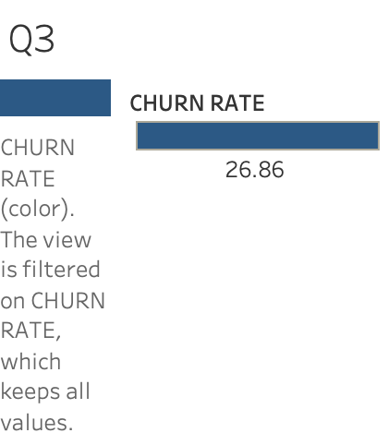

Slide 5
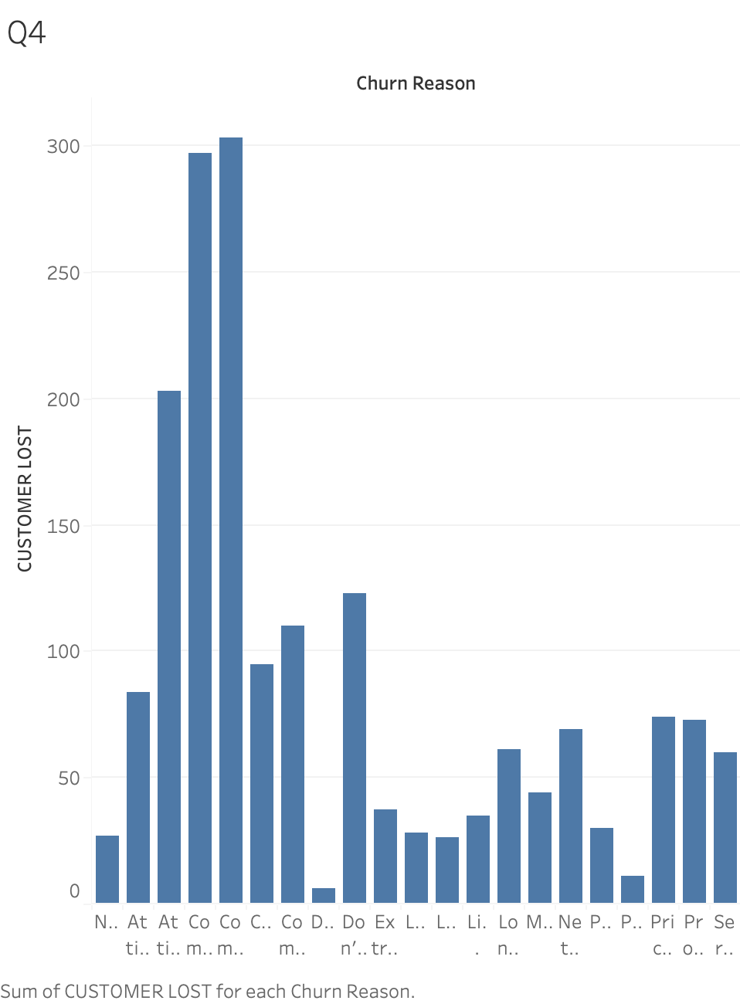

Slide 6
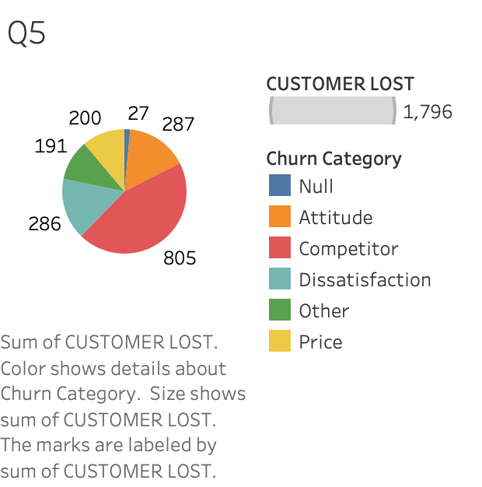

Slide 7
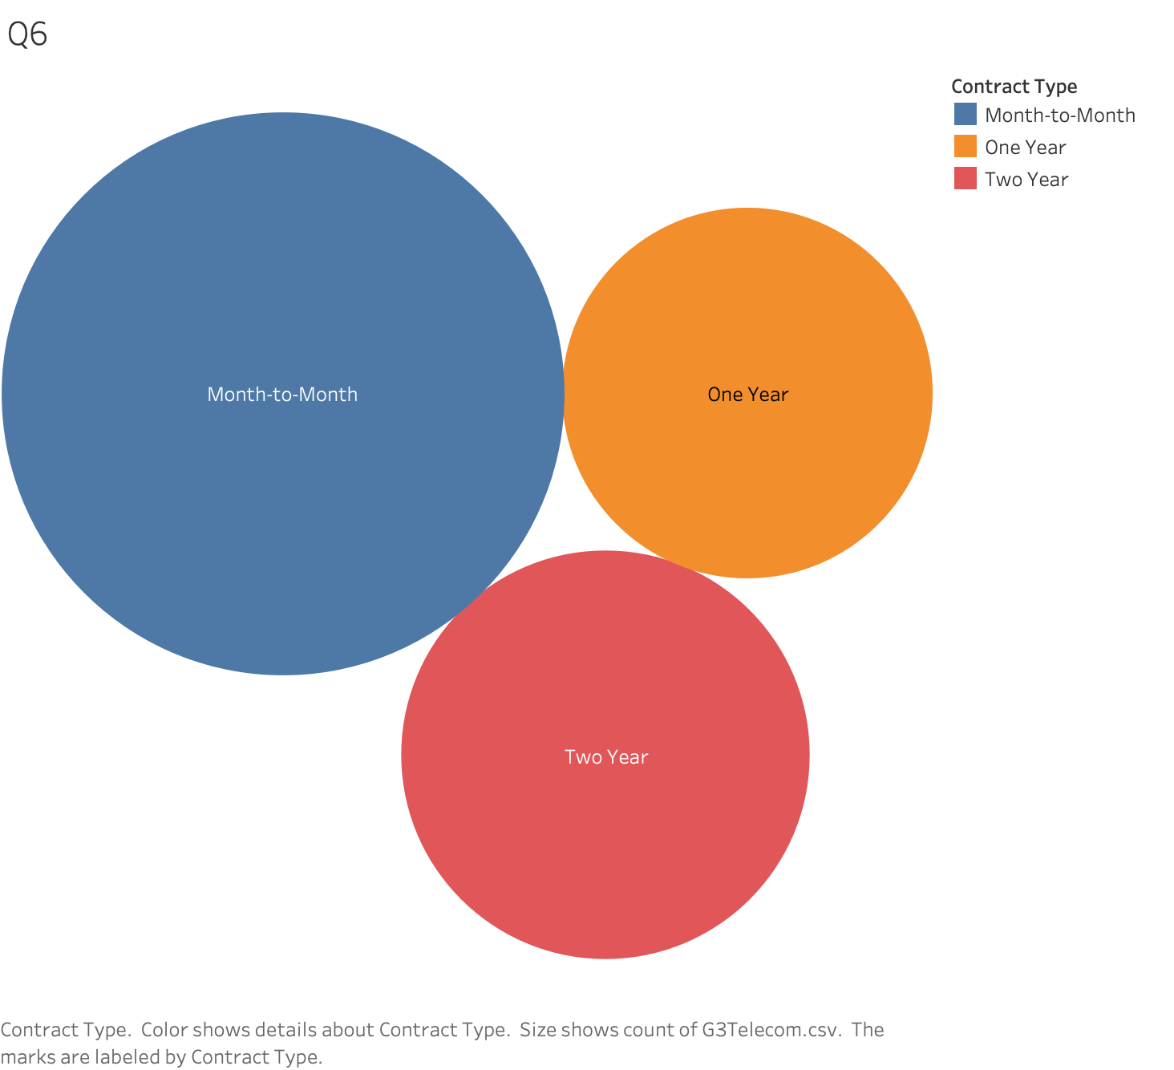

Slide 8
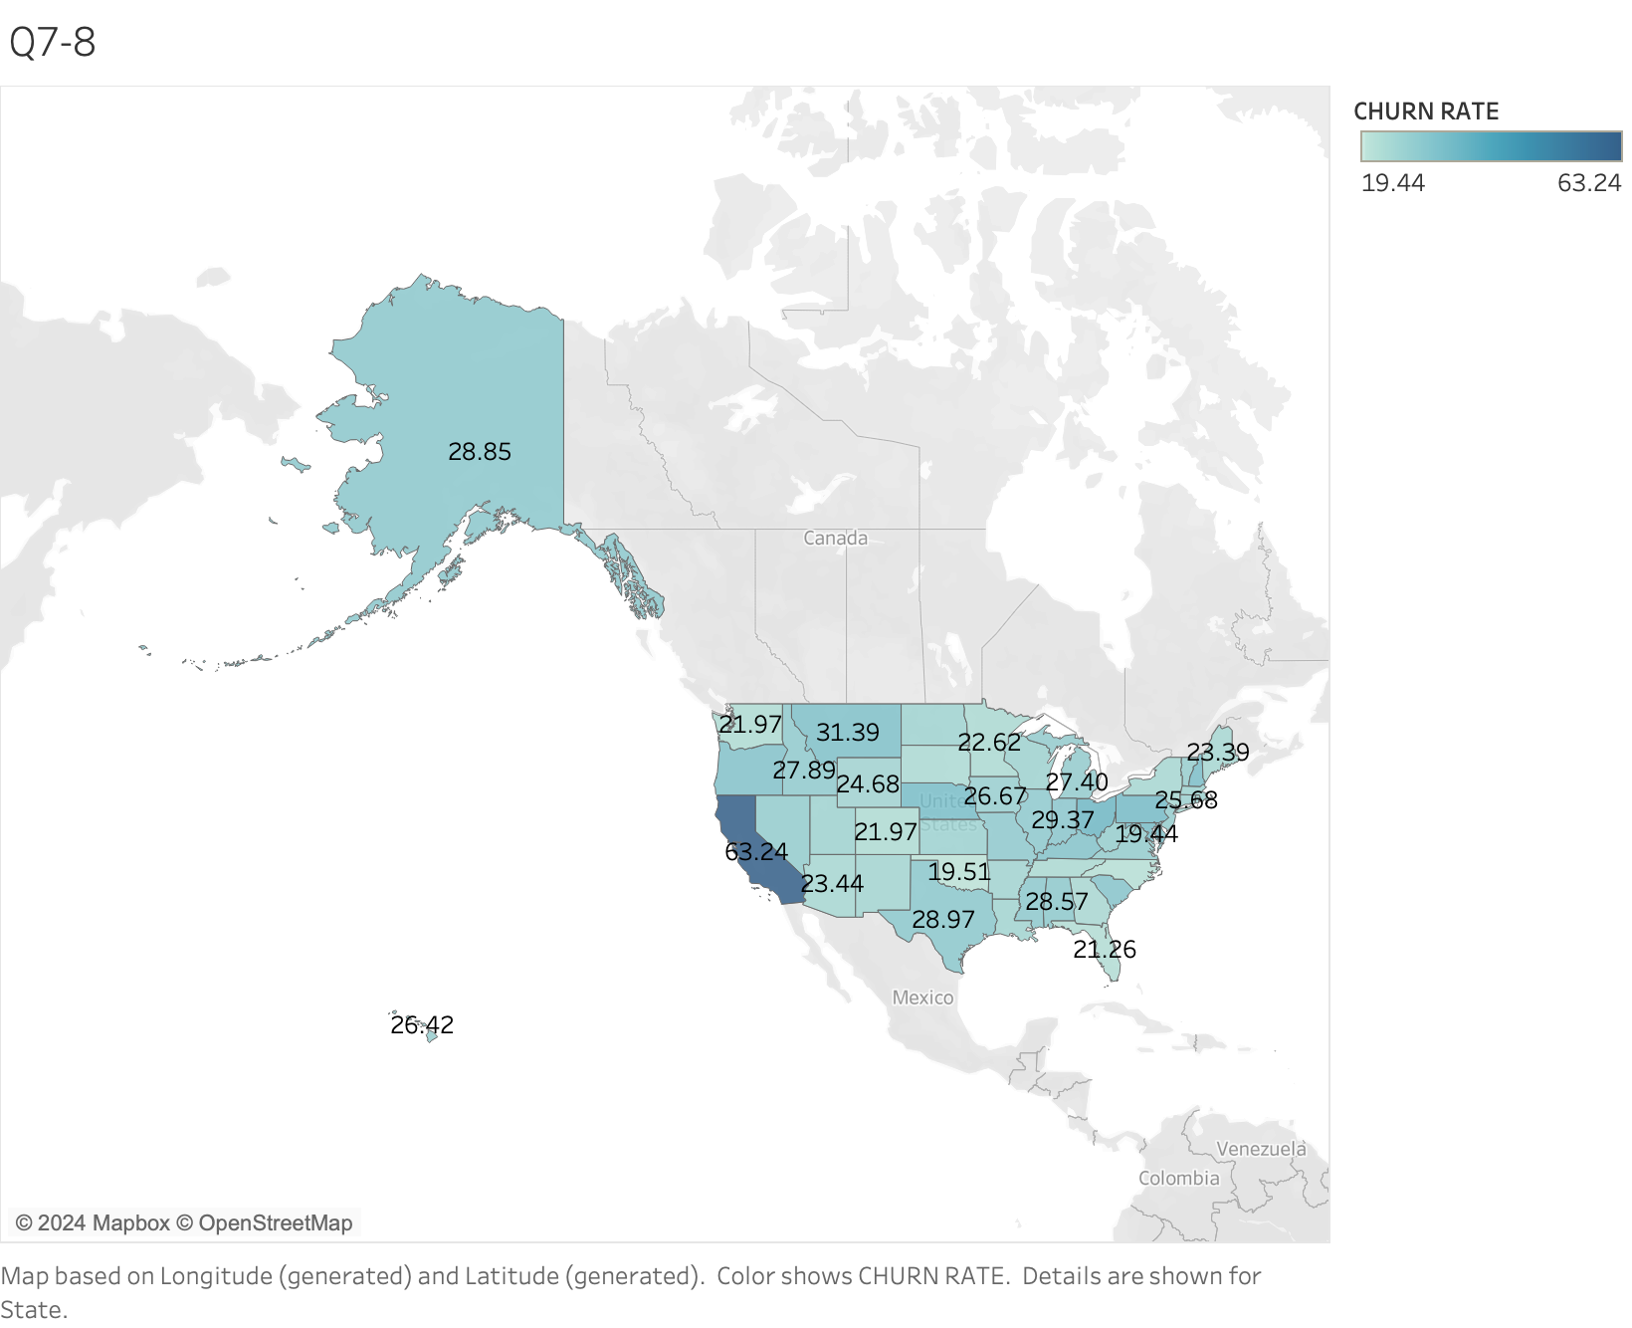

Slide 9
